Slide 1

Welcome to the 11th Annual CORA for Kids Golf Classic

Slide 2

Today’s Live Auction
COME GOLF AGAIN AT THE PHILADELPHIA CRICKET CLUB!
1 Round of Golf with Carts on
The Cricket Club’s Militia Hill Course
What’s Your Bid?

Slide 3

Presenting Sponsor

Slide 4


Charity’s Circle Sponsor
Plumbers Union Local 690

Slide 5
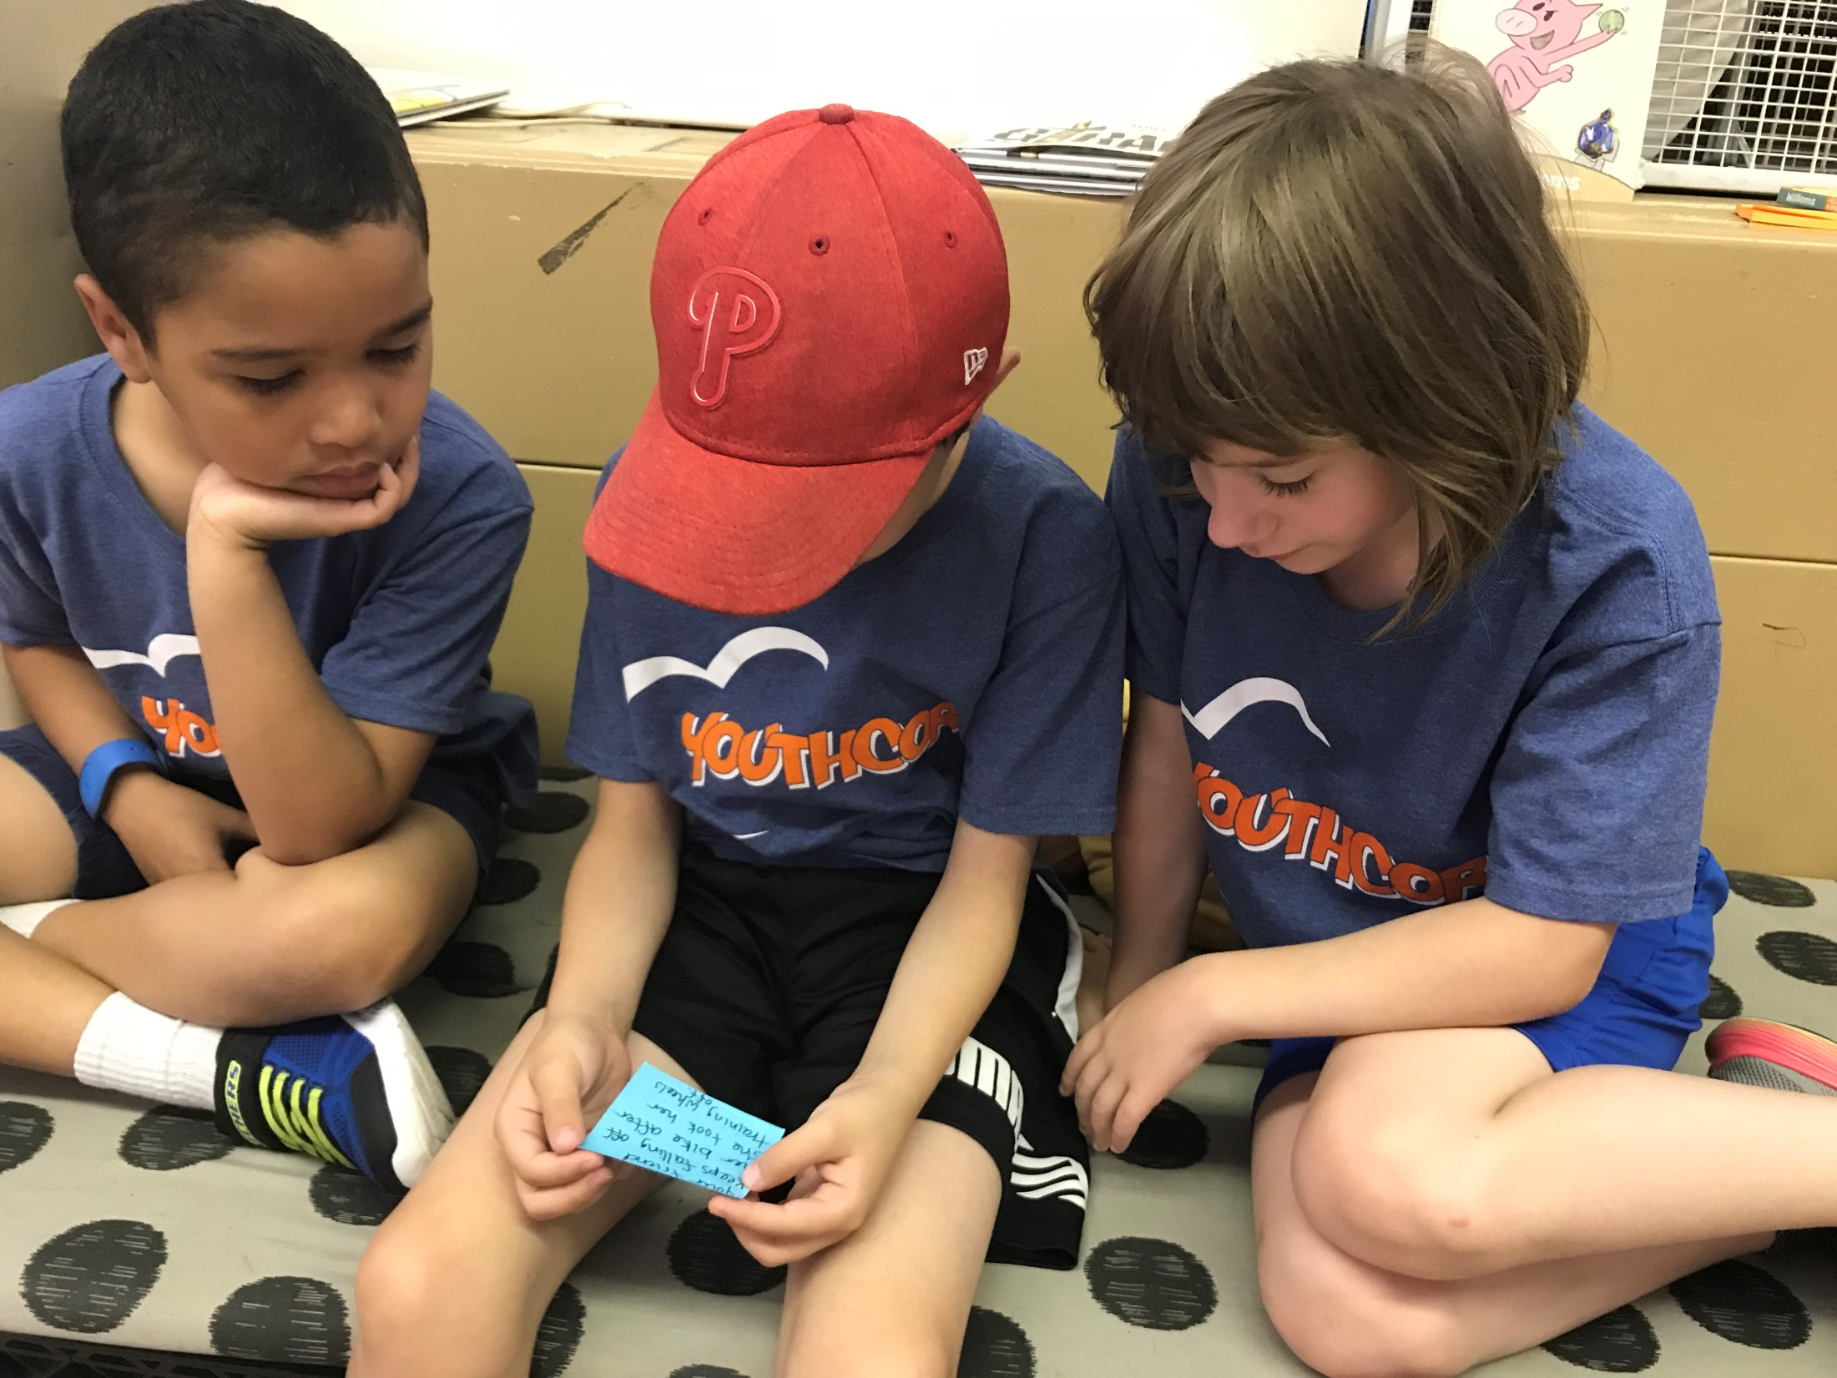
YouthCOR – Afterschool Programming

Slide 6
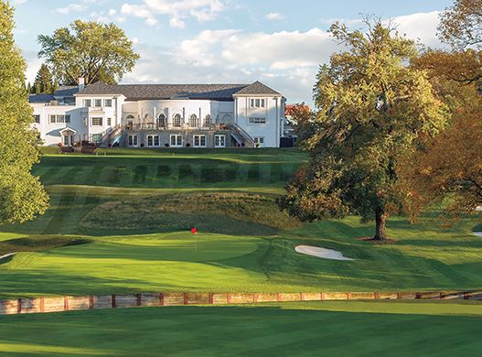
Today’s Live Auction
Golf at the Union League
1 Round of Golf with Carts
Beautiful Private 18 hole
Donald Ross Course in
Northeast Philadelphia!
What’s Your Bid?

Slide 7




Caring Sponsors

Slide 8
Presenting Sponsor

Slide 9
Charity’s Circle Sponsor
Plumbers Union Local 690

Slide 10
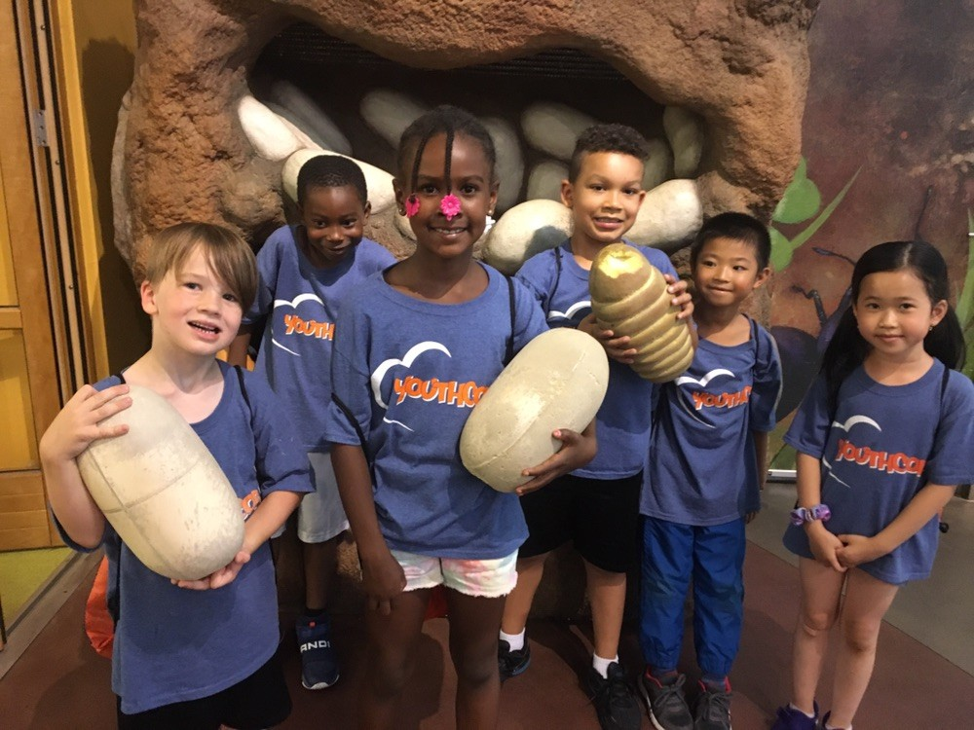
CORA YOUTHCOR Summer Camp

Slide 11



Caring Sponsors

Slide 12
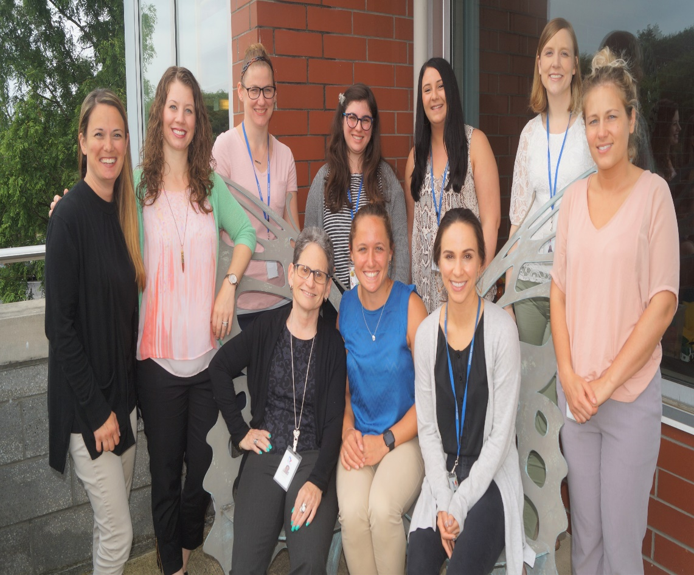

Slide 13



Caring Sponsors

Slide 14
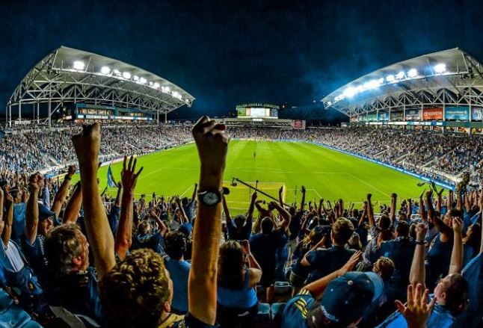

Today’s Live Auction
Soccer Package
4 Exclusive Field Side Seats!
Food and Beverages Included
VIP Parking Passes
Union vs. DC United
Saturday, August 24, 2019
7:30 p.m. Talen Energy Stadium
What’s Your Bid?

Slide 15
Presenting Sponsor

Slide 16
Charity’s Circle Sponsor
Plumbers Union Local 690

Slide 17
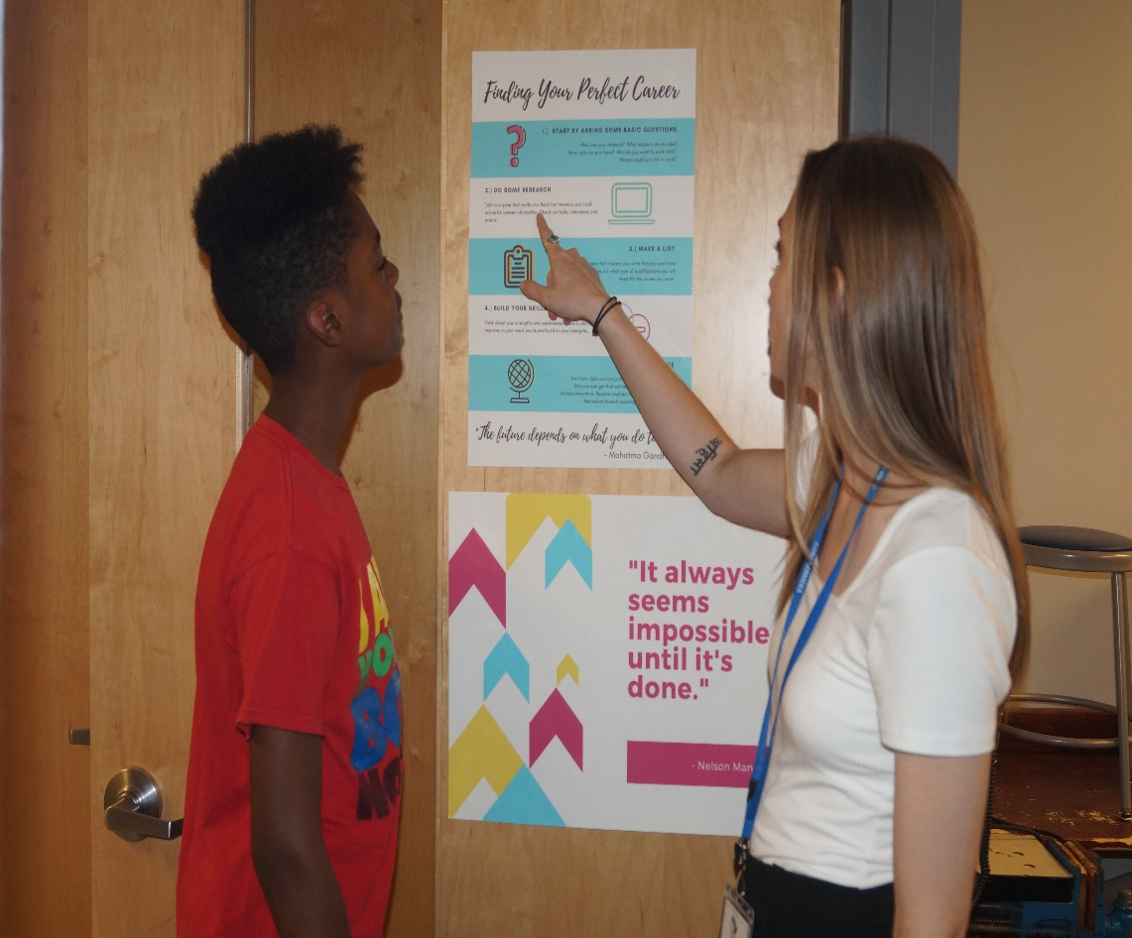
CORA Counselors and Case Managers show guidance

Slide 18
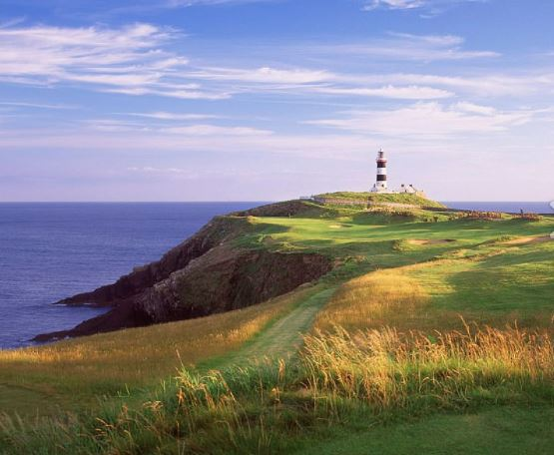
Today’s Live Auction
CELTIC GOLF TRIP FOR TWO!
5 Days, 4 Nights in IRELAND!
4 Nights at the 5 Star Killarney Park Hotel
3 Rounds of Golf:
Old Head, Tralee and Waterville
Hertz Car Rental for 5 Days
Daily Irish Breakfast
What’s Your Bid?

Slide 19



Caring Sponsors
Sisters of The Good Shepherd

Slide 20
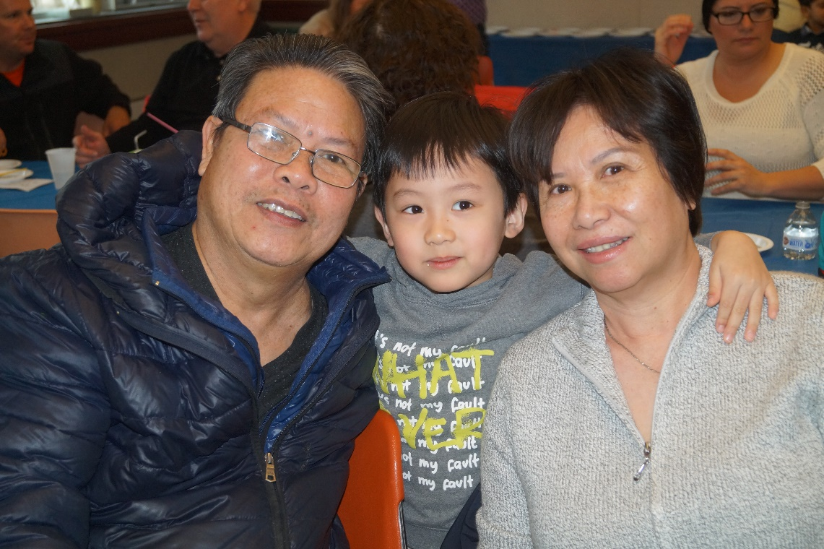
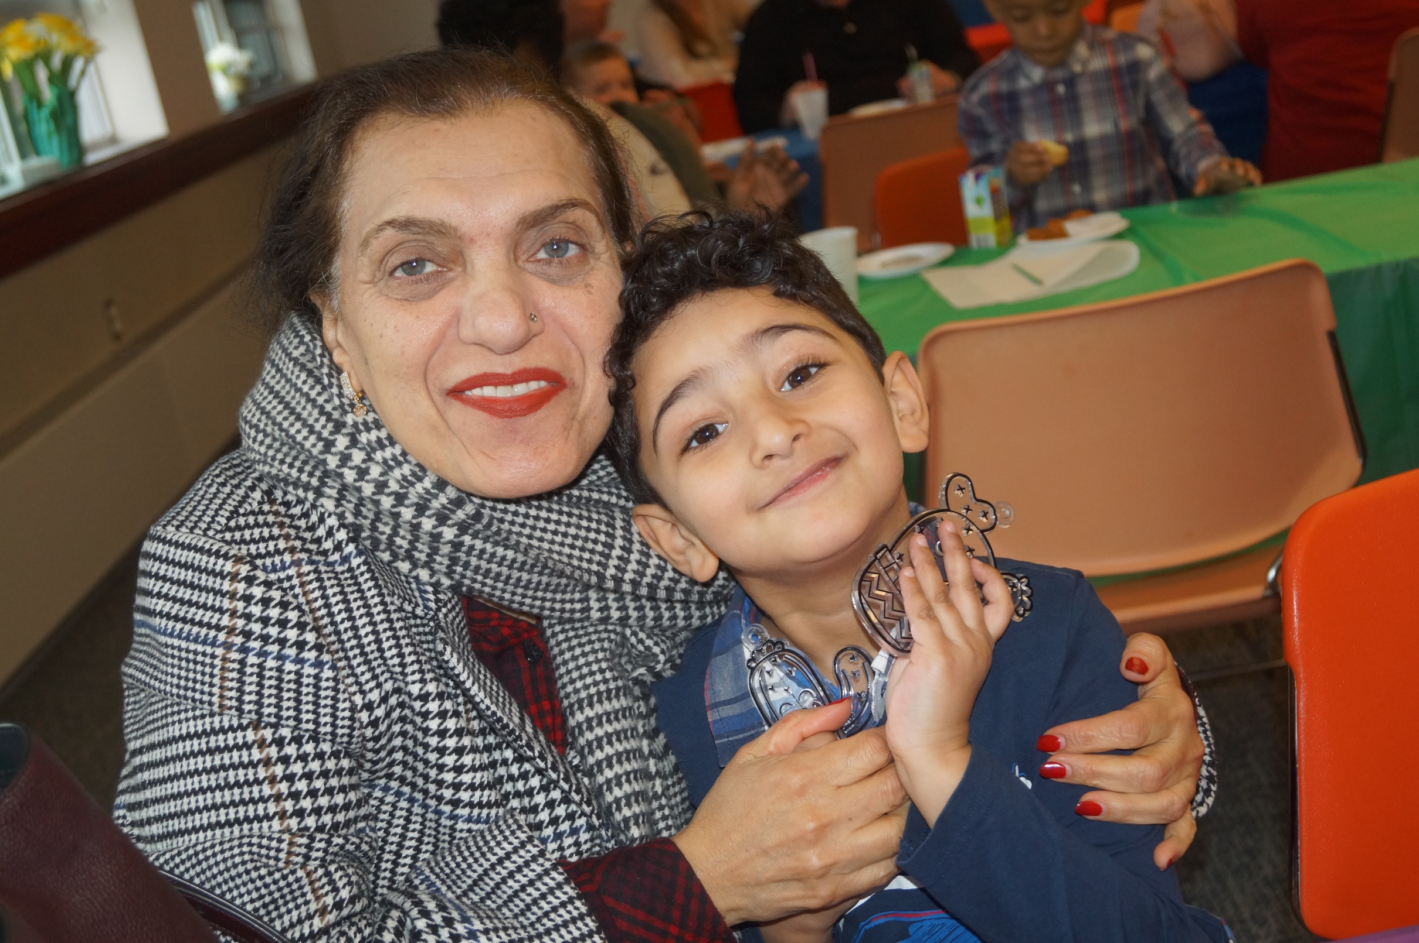
CORA supports children, youth and families

Slide 21

Media Sponsor

Slide 22
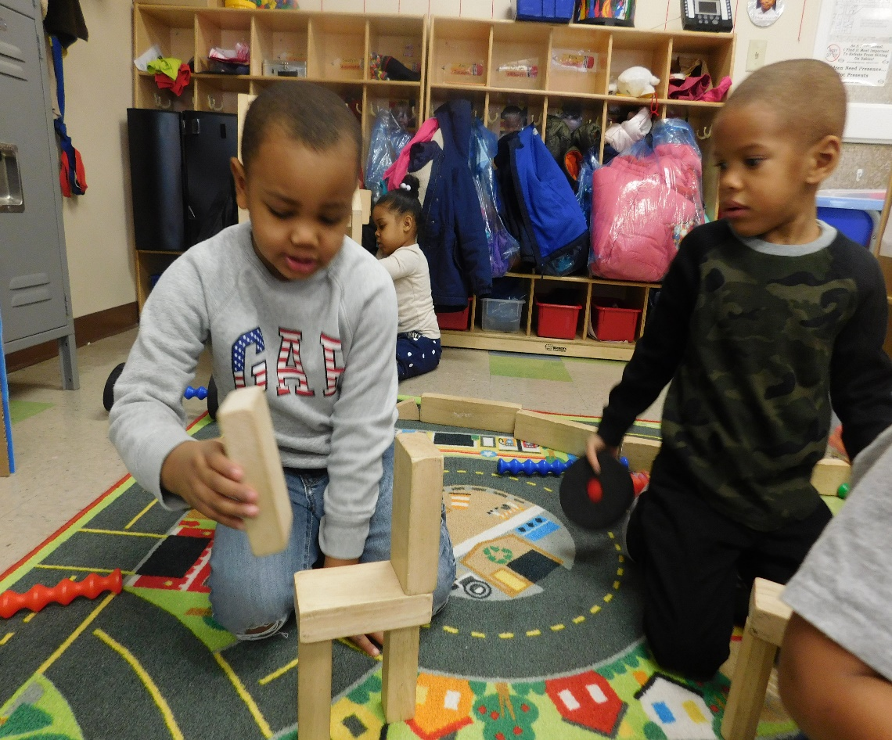
CORA is building a third Early Years Program !

Slide 23

On-Course Beverages

Slide 24

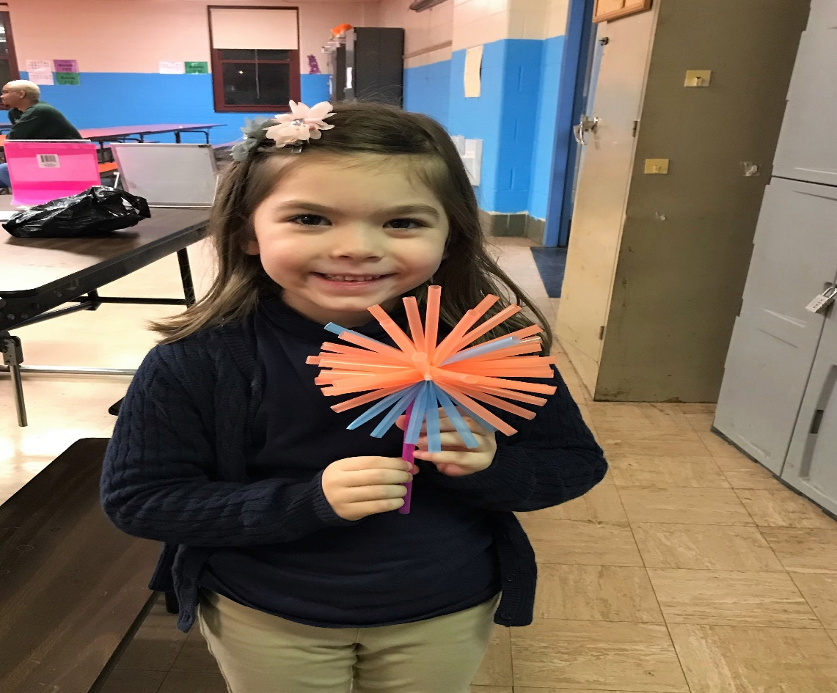

Slide 25



Driving Range/Putting Green

Slide 26
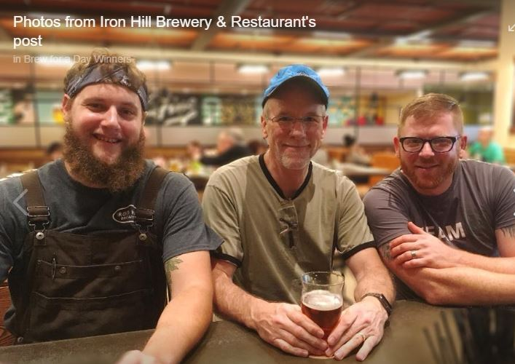
Today’s Live Auction
Brew Day Experience for 2 at Iron Hill!
You and a friend will assist in brewing a special seasonal beer and then return when that beer is released for a
Chef’s Choice Dinner for 6!
Dinner for your group will consist of a special pairing menu featuring your beer. All food and beverages included.
What’s Your Bid?

Slide 27
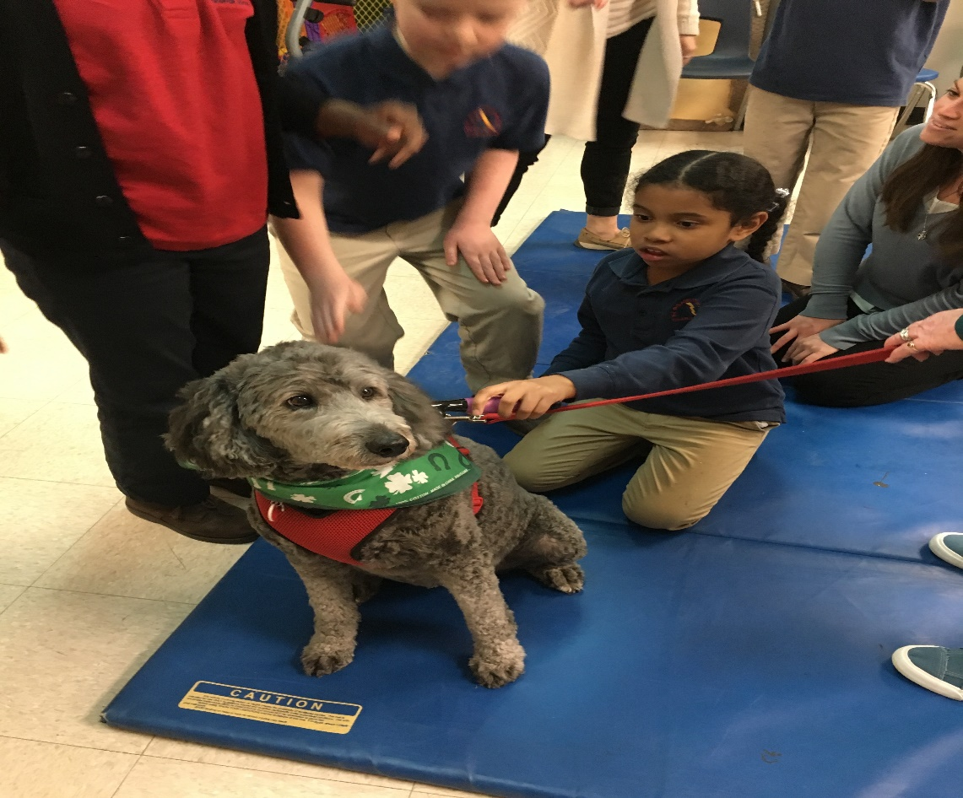
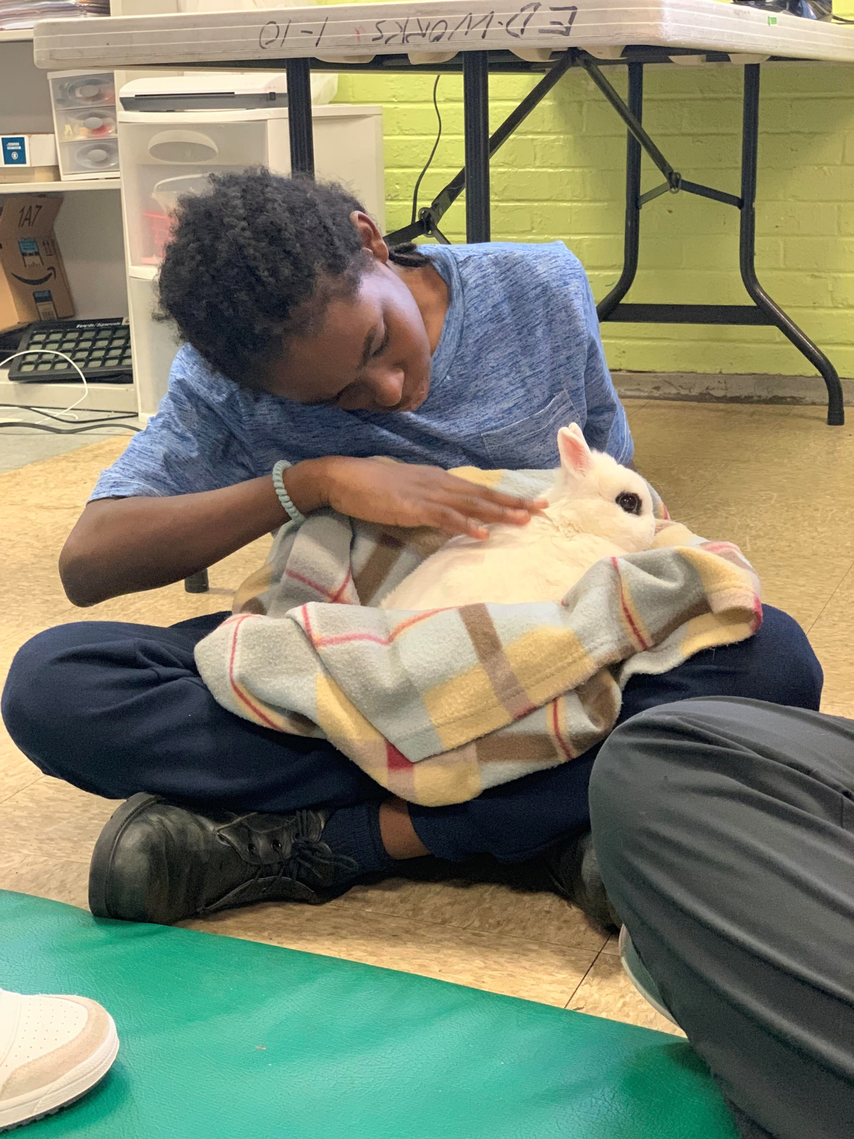
CORA’ OT and Speech Therapists use Pet therapy

Slide 28





Hole Sponsors

Slide 29
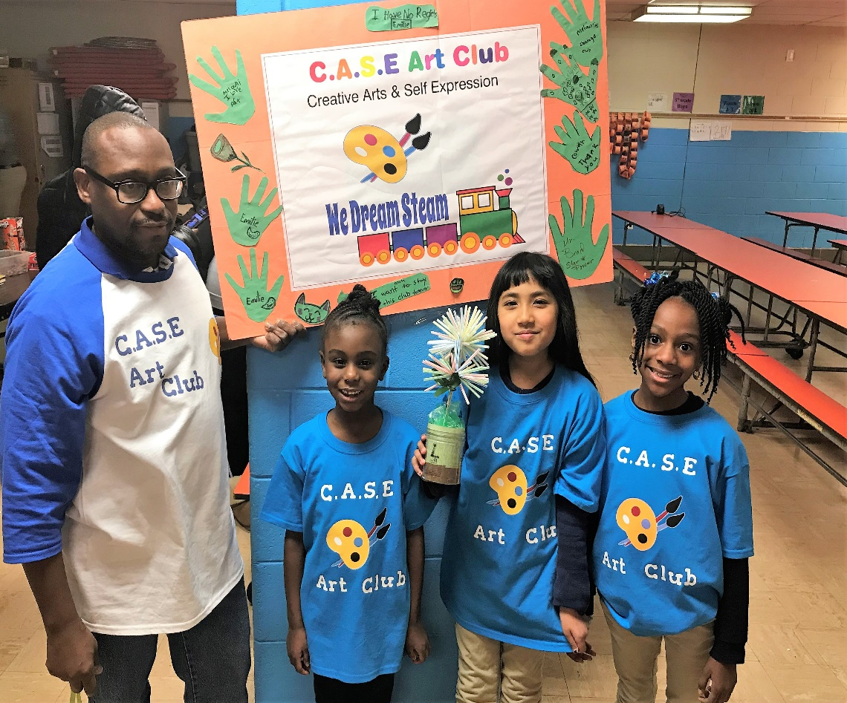

Slide 30
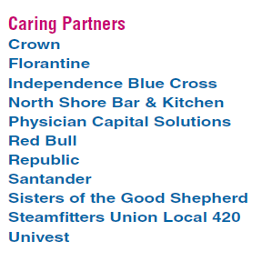
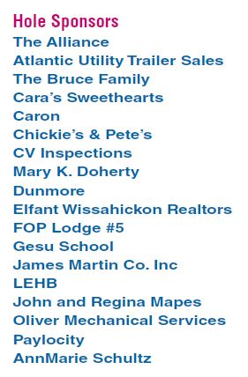
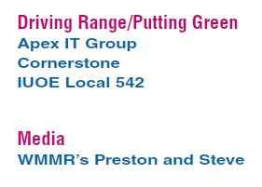

Slide 31
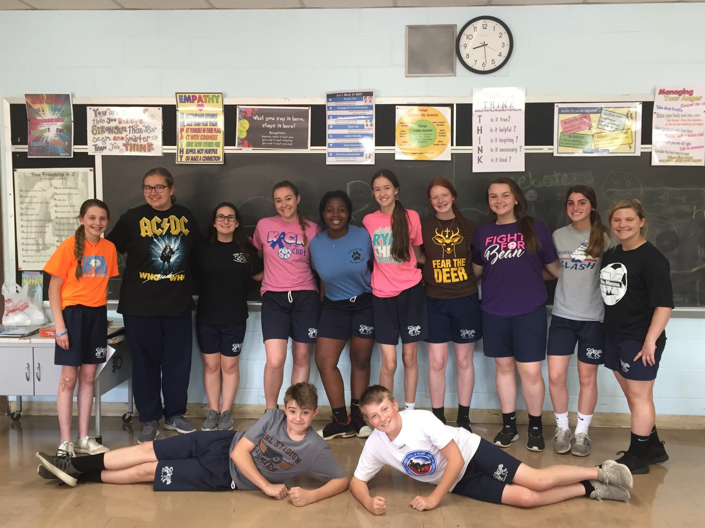

Slide 32





Hole Sponsors

Slide 33
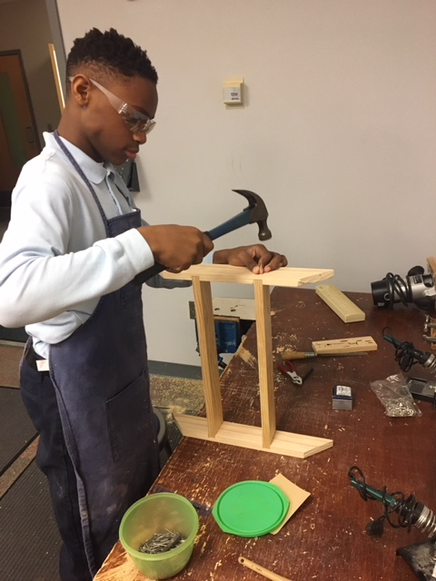
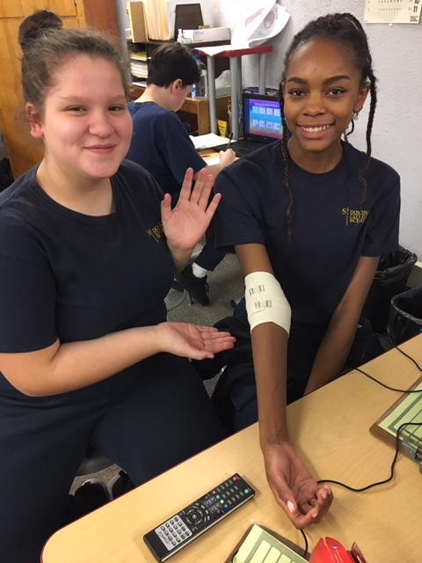
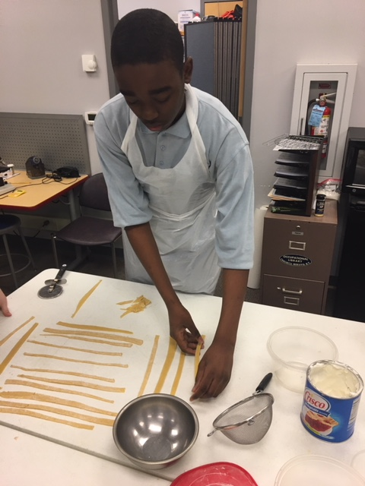
CDRC – Career Development Resource Center

Slide 34




Hole Sponsors
Mary K Doherty
AnnMarie Schultz
The Bruce Family

Slide 35
